Slide 1
Mindfulness 101
Week 3

Slide 2
Class Flow
01
02
03
04
Check-in and Recap
Mini Lesson
Mindfulness
Practice
Prep for next week / QA

Slide 3
Check-In
One word that captures how you are feeling
Practice share ( breath, eating, or walking)

Slide 4
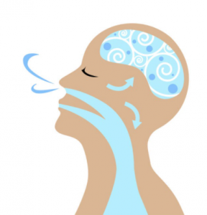
Mindful Breathing

Slide 5
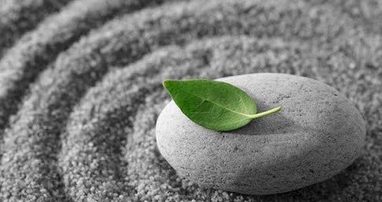
Mindfulness
A particular type of awareness that arises through paying attention to the moment, on purpose and non-judgmentally
...more simply, practicing mindfulness is learning to notice our experiences in the moment with intention

Slide 6
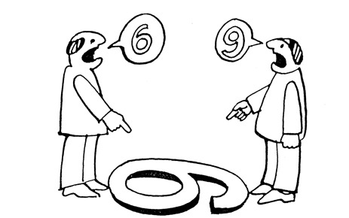

Slide 7
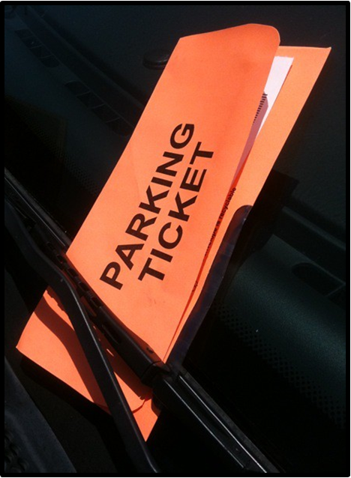
The Parking Ticket
Engage your senses: Try to immerse yourself fully in the experience. See the colors, shapes, and details. Hear the sounds, smell the scents, and feel the sensations associated with the scene.
Personalize: Infuse the scene with elements from your personal life making it more meaningful and relevant to your own journey.
Embrace the emotions: Let your emotions arise naturally as you immerse yourself in the scene. Embrace these emotions and let them deepen your connection to the experience.

Slide 8
Monkey Mind

Slide 9
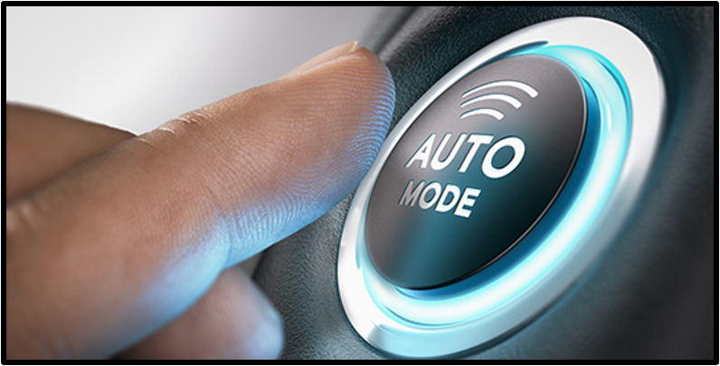
Autopilot
Happening automatically or doing something automatically, without having to think about what you are doing; not being fully aware

Slide 10
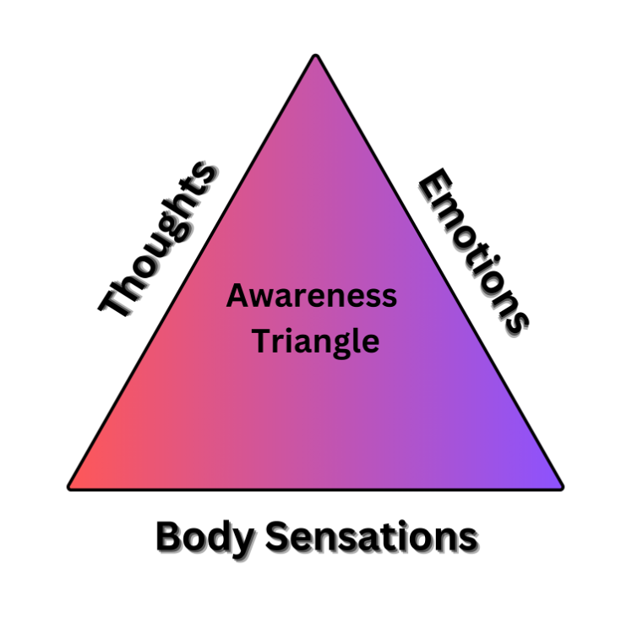
Awareness Triangle
What do I feel in my body?
What emotions do I notice?
What Thoughts are going through my mind

Slide 11
Radar
Stay present and attuned to the present moment,
Navigate with greater clarity, focus, and insight.
Foster a deeper connection with yourself and the world around you.

Slide 12
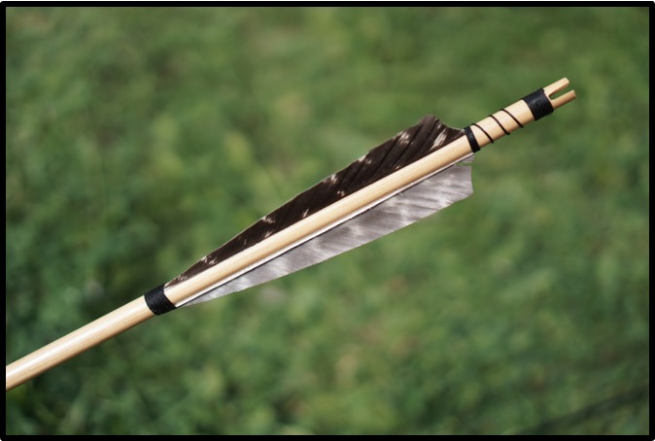
Parable of the Poisoned Arrow
There was once a man who was hurt by a poisoned arrow.
The family and friends wanted to get him a doctor but the patient
refused, saying that he first wanted to know the name of the man
who had wounded him, the caste to which he belonged and his
country of origin.

Slide 13
Parable of the Poisoned Arrow
He also wanted to know if the man was tall and strong if he had a
light or dark skin and he wished to know what kind of bow
wounded him, whether the rope was made of bamboo, hemp or
silk.

Slide 14
Parable of the Poisoned Arrow
He said he wanted to know if the feather of the arrow belonged to
a hawk, vulture or peacock…
And he wondered if the bow that had been used to strike him was
a common bow, curved or made with oleander and any other kind
of information...
the man died without ever knowing the answers

Slide 15
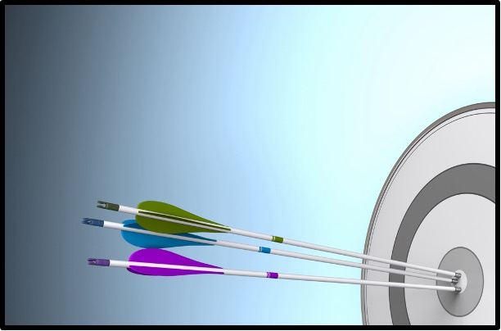
1st Arrow: Arrow of Circumstance
2nd + Arrow(s): Arrow(s) We Shoot At Ourselves

Slide 16
Mindful Breathing (Anchor)

Slide 17
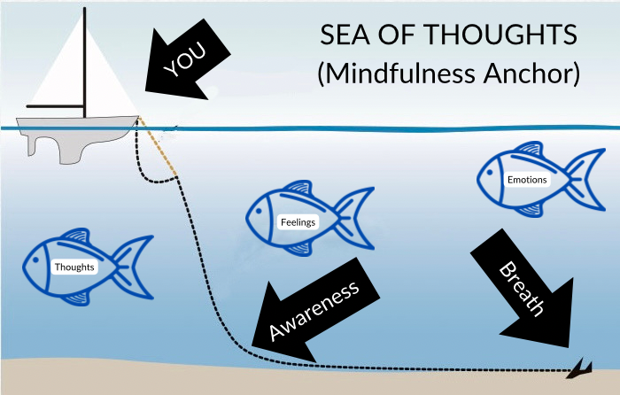
Anchor

Slide 18
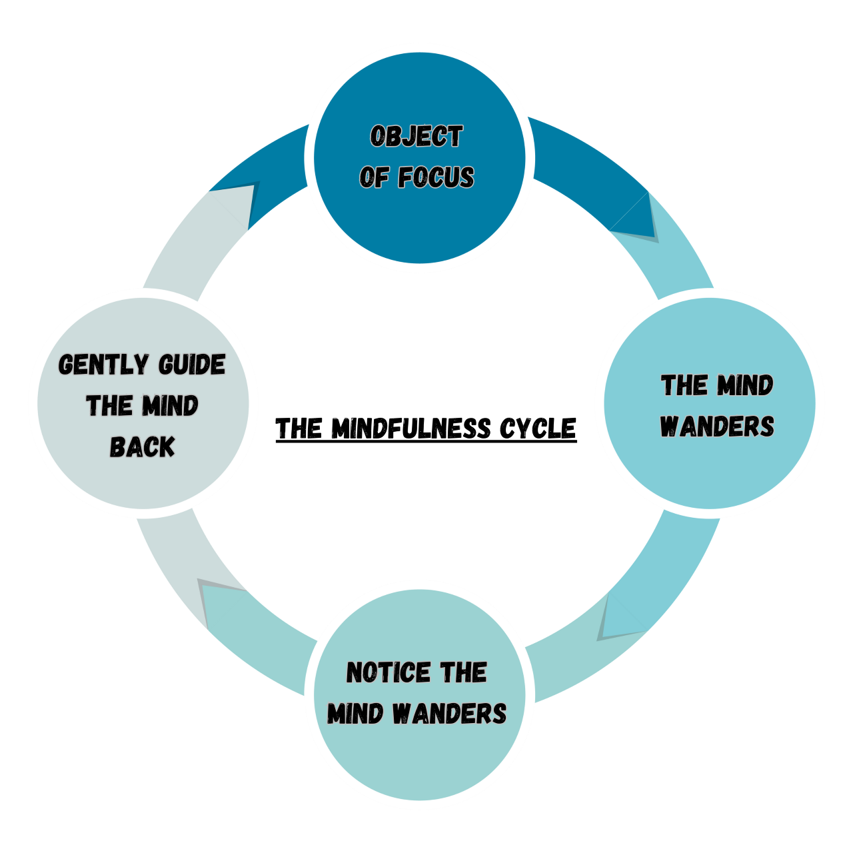
Mindfulness Cycle
The four-phase cycle in which one actively engages in self directed focus to recognize the nature of thought and experience.

Slide 19
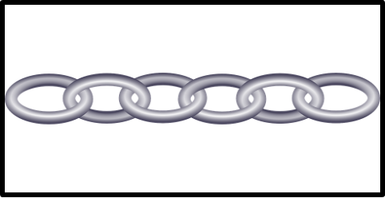
Linking
Creating an association to particular stimuli to promote a specific action, or way of thinking and feeling

Slide 20
Stop Light Method
1. S=STOP: stop where you are and acknowledge how you are feeling in
the moment.
2. T=TAKE A BREATH: refocus your attention using your breath as a point
of focus.
3. O=OBSERVE: Observe your body sensations, your thoughts, and your
feelings around what is happening.
Be with these sensations for a minute or two, show yourself compassion
and then gradually expand your awareness around the feelings, creating
space for them.
4. P=PROCEED: continue, bringing a more skillful response to the
situation.

Slide 21
The Journey by Mary Oliver
One day you finally knew what you had to do, and began, though the voices around you kept shouting their bad advice-- though the whole house began to tremble and you felt the old tug at your ankles. "Mend my life!" each voice cried.
But you didn't stop. You knew what you had to do, though the wind pried with its stiff fingers at the very foundations, though their melancholy was terrible. It was already late enough, and a wild night, and the road full of fallen branches and stones. But little by little, as you left their voices behind, the stars began to burn through the sheets of clouds, and there was a new voice which you slowly recognized as your own, that kept you company as you strode deeper and deeper into the world, determined to do the only thing you could do-- determined to save the only life you could save.

Slide 22
The Guest House by Rumi
This being human is a guest house.
Every morning a new arrival.
A joy, a depression, a meanness, some momentary awareness comes as an unexpected visitor.
Welcome and entertain them all!
Even if they’re a crowd of sorrows, who violently sweep your house empty of its furniture, still, treat each guest honorably.
He may be clearing you out for some new delight. The dark thought, the shame, the malice, meet them at the door laughing, and invite them in.
Be grateful for whoever comes, because each has been sent as a guide from beyond.

Slide 23
Bio-Break

Slide 24
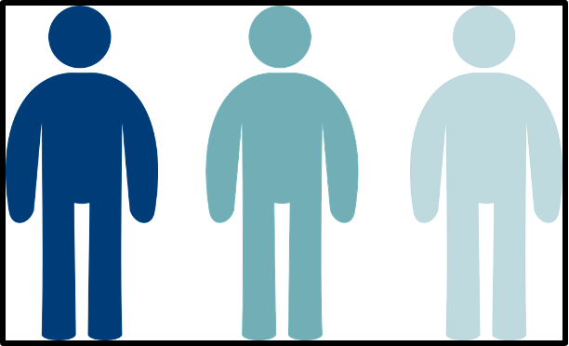
Body Scan

Slide 25
Homework
1) Do the mindful breathing practice for 5 mins everyday 2) Reread “The Journey” by Mary Oliver 3) Do the body scan practice 3 times this week 4) Complete ”Noticing My Thoughts” (Unpleasant) 5) Write or make a mental list of 10 things you are grateful for

Slide 26
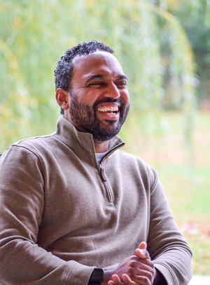
Thank You!
Have questions?
engage@copperbeechinstitute.org
Copper Beech Institute

