Slide 1
Mindfulness 101
Week 2

Slide 2
Class Flow
01
02
03
04
Check-in and Recap
Mini Lesson
Mindfulness
Practice
Prep for next week / QA

Slide 3
Check-In
Internal Weather Forecast
Any moments you caught yourself being mindful
Something that brought you joy

Slide 4
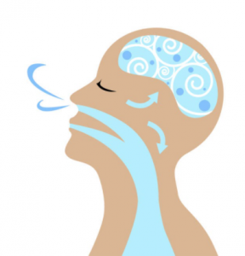
Mindful Breathing

Slide 5
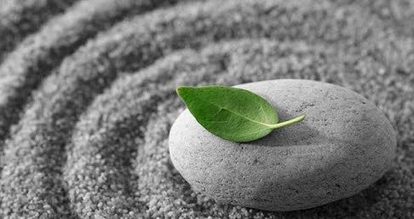
Mindfulness
A particular type of awareness that arises through paying attention to the moment, on purpose and non-judgmentally
...more simply, practicing mindfulness is learning to notice our experiences in the moment with intention

Slide 6
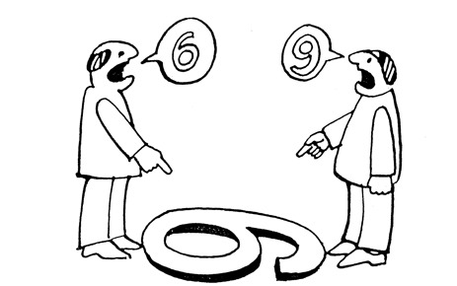

Slide 7
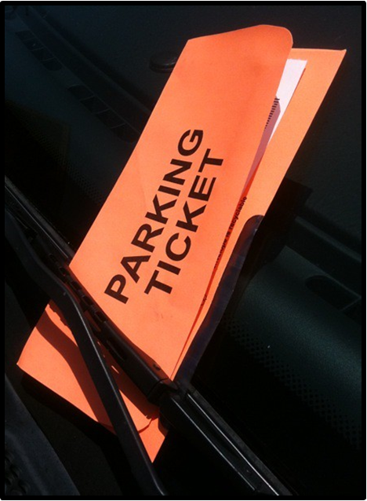
The Parking Ticket
Engage your senses: Try to immerse yourself fully in the experience. See the colors, shapes, and details. Hear the sounds, smell the scents, and feel the sensations associated with the scene.
Personalize: Infuse the scene with elements from your personal life making it more meaningful and relevant to your own journey.
Embrace the emotions: Let your emotions arise naturally as you immerse yourself in the scene. Embrace these emotions and let them deepen your connection to the experience.

Slide 8
Monkey Mind

Slide 9
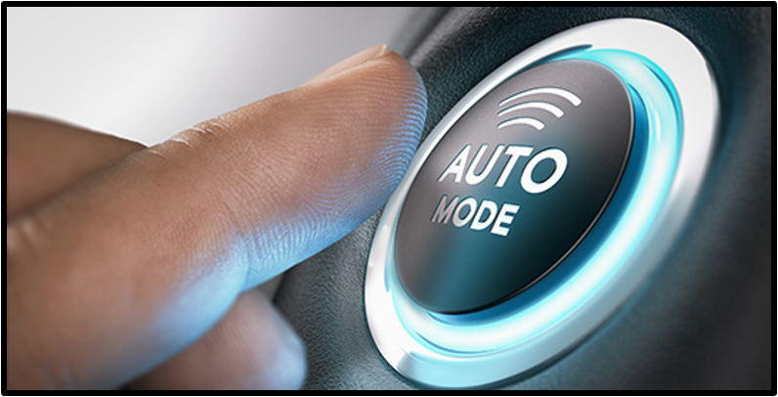
Autopilot
Happening automatically or doing something automatically, without having to think about what you are doing; not being fully aware

Slide 10
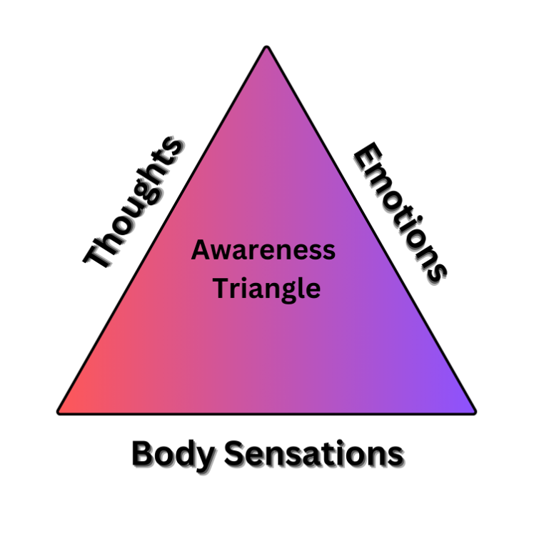
Awareness Triangle
What do I feel in my body?
What emotions do I notice?
What Thoughts are going through my mind

Slide 11
Radar
Stay present and attuned to the present moment,
Navigate with greater clarity, focus, and insight.
Foster a deeper connection with yourself and the world around you.

Slide 12
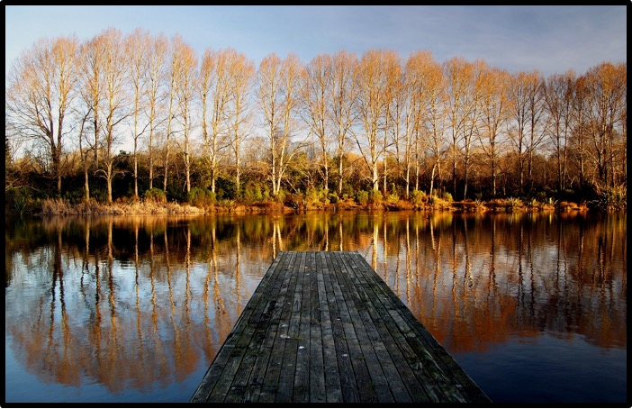
The Peace of Wild Things By: Wendell Berry
When despair for the world grows in me and I wake in the night at the least sound in fear of what my life and my children’s lives may be, I go and lie down where the wood drake rests in his beauty on the water, and the great heron feeds.
I come into the peace of wild things who do not tax their lives with forethought of grief. I come into the presence of still water. And I feel above me the day-blind stars waiting with their light.
For a time I rest in the grace of the world, and am free.

Slide 13
Bio-Break

Slide 14
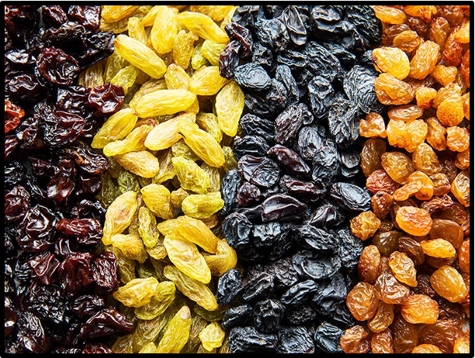
Mindful Eating

Slide 15
Homework
1) Continue with mindful breathing practice 2) Reread “ The Peace of the Wild Things” 3) Practice Mindful eating 3 times 4) Practice Mindful Walking 3 times 5) Complete “Noticing my Thoughts (Positive

Slide 16
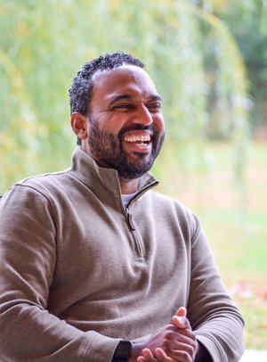
Thank You!
Have questions?
engage@copperbeechinstitute.org
Copper Beech Institute

