Slide 1

Mindfulness 101
Week 1

Slide 2
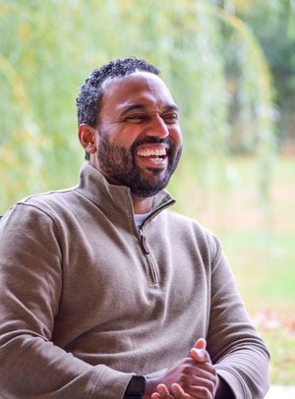
INTRODUCTION
Hi I’m Brian Thompson
Director of Community Engagement
Masters in Mindfulness Studies

Slide 3
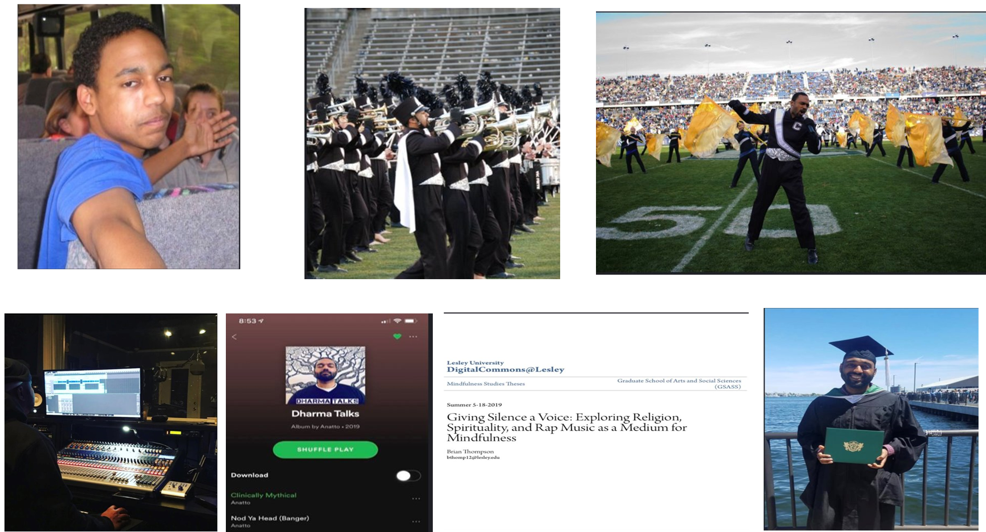

Slide 4
Class Guidelines
If possible, arrive early to allow time to settle into class
If you will be absent from class, please let me know
Please maintain confidentiality of all personal information in class
Please silence the ringers on electronic devices
Please avoid scented products in consideration of those who have environmental sensitivities
Practice self-care! Remember, everything is an invitation. If a practice does not feel “right” for you, please STOP and make any adjustments you might need. If you need to take a short break, use the restroom you, or you need to step out for any other reason, please do. Trust and do what is “right” for you! 😊
“This is the real secret of life -- to be completely engaged with what you are doing in the here and now. And instead of calling it work, realize it is play.”
- Alan Watts

Slide 5
Class Flow
01
02
03
04
Check-in and Recap
Mini Lesson
Mindfulness
Practice
Prep for next week / QA

Slide 6
Check-In
Name
Something you hope to get out of class
An interesting fact about yourself

Slide 7

Brain Games
Look over the illusions and puzzle
Discuss what you see and why we might be starting with this activity

Slide 8
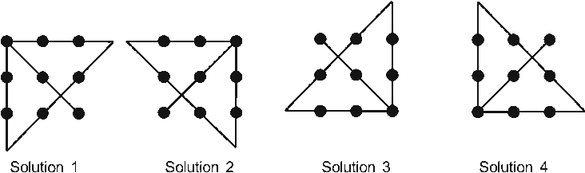



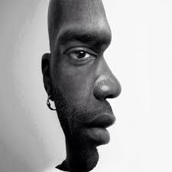

Slide 9
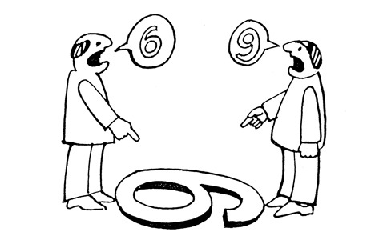

Slide 10

Monkey Mind

Slide 11

Mindfulness
A particular type of awareness that arises through paying attention to the moment, on purpose and non-judgmentally
...more simply, practicing mindfulness is learning to notice our experiences in the moment with intention

Slide 12

Autobiography in Five Short Chapters
By Portia Nelson
Chapter 1
I walk down the street. There is a deep hole in the sidewalk. I fall in I am lost…I am helpless It isn’t my fault. It takes forever to find a way out.

Slide 13
Autobiography in Five Short Chapters
By Portia Nelson
Chapter 2
I walk down the same street. There is a deep hole in the sidewalk. I pretend I don’t see it. I fall in again. I can’t believe I am in the same place. But it isn’t my fault. It still takes a long time to get out.

Slide 14
Autobiography in Five Short Chapters
By Portia Nelson
Chapter 3
I walk down the same street There is a deep hole in the sidewalk. I see it is there. I still fall in…it’s a habit. My eyes are open I know where I am. It’s my fault. I get out immediately

Slide 15
Autobiography in Five Short Chapters
By Portia Nelson
Chapter 4
I walk down the same street. There is a deep hole in the sidewalk. I walk around it.

Slide 16
Autobiography in Five Short Chapters
By Portia Nelson
Chapter 5
I walk down another street.

Slide 17
Bio-Break

Slide 18
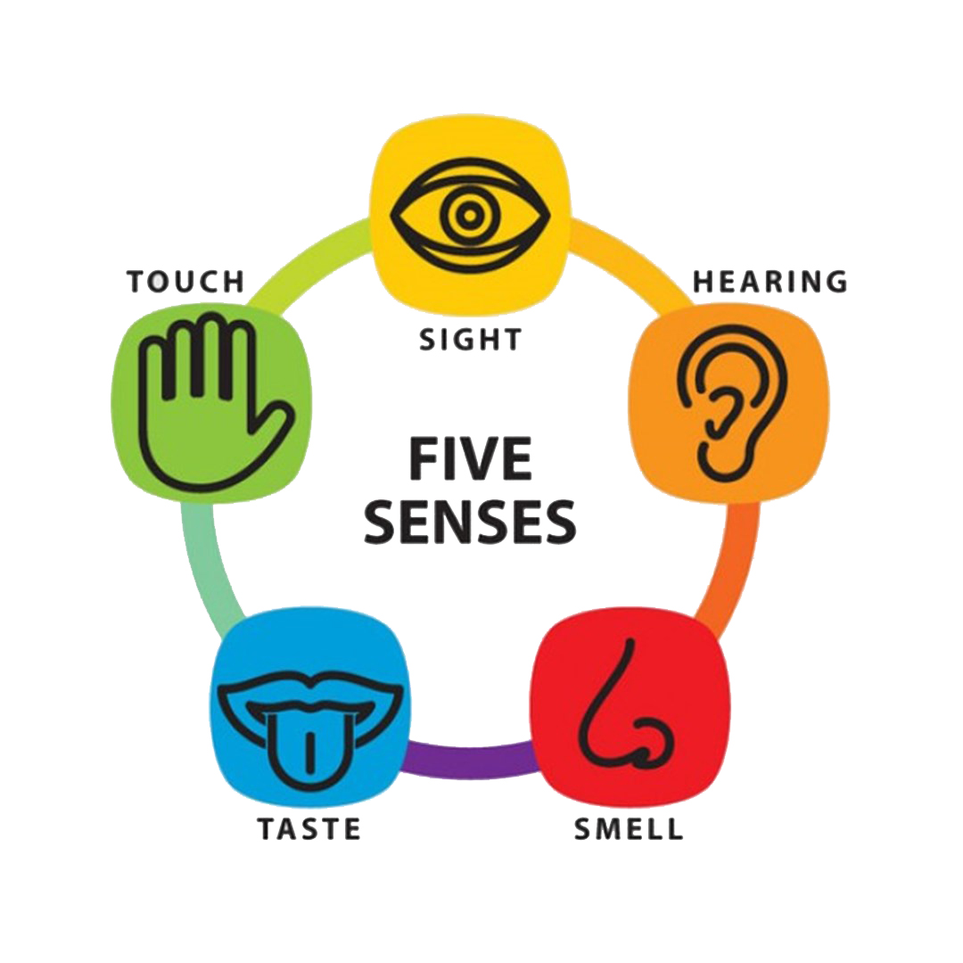

5 Senses Practice
Mindful Breathing

Slide 19
Thank You!
Have questions?
engage@copperbeechinstitute.org
Copper Beech Institute

